Slide 1
DataMining Project 1
Q56061040 湯立婷

Slide 2
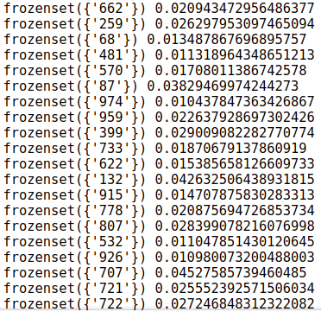
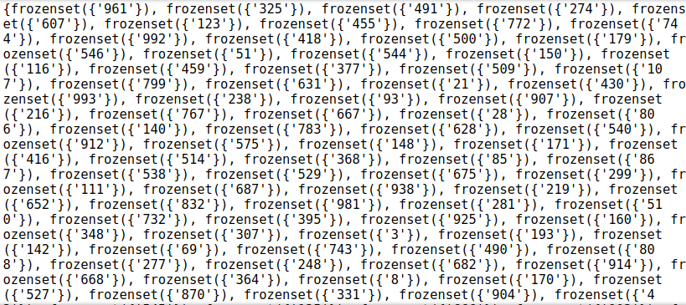
Implement Apriori Algorithm
min_support=0.01, min_conf=0.3

Slide 3
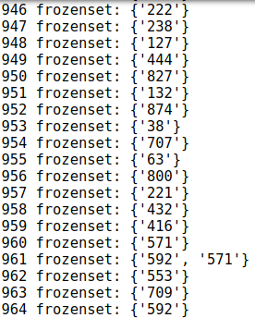
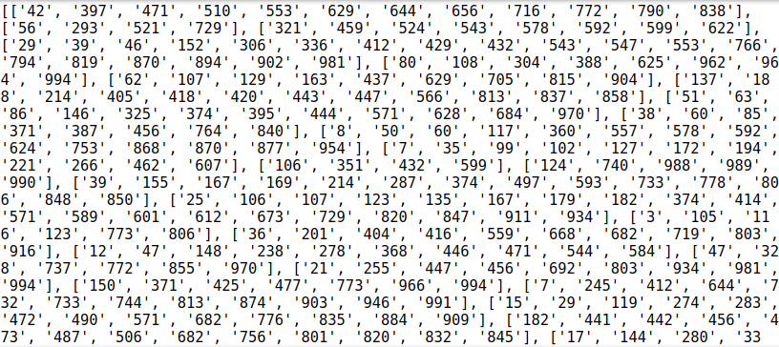
Implement FP Growth Algorithm
min_support=0.01

Slide 4
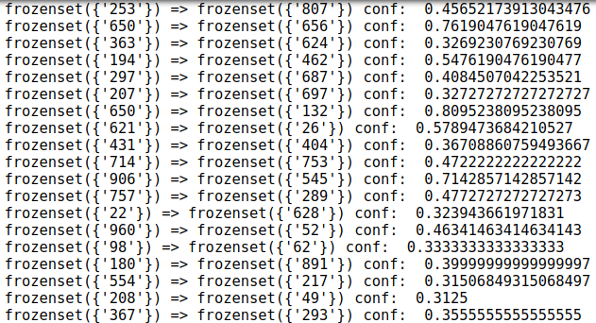
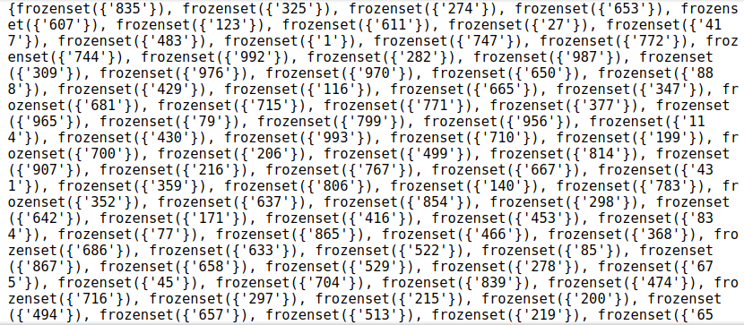
Implement Apriori Algorithm
min_support=0.001, min_conf=0.3

Slide 5
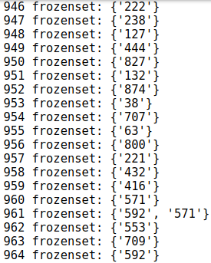
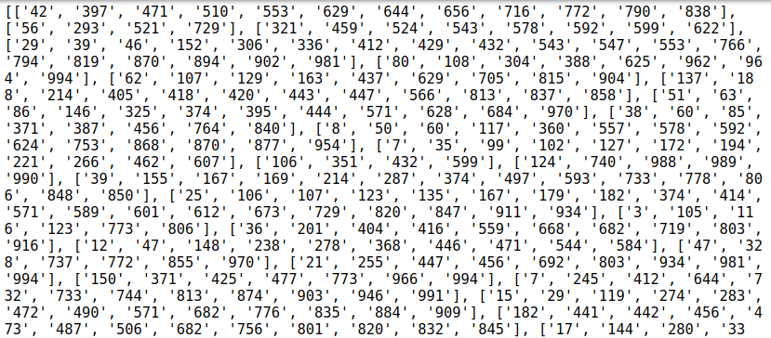
Implement FP Growth Algorithm
min_support=0.001

Slide 6
Performance Comparation
 | Apriori | FP Growth
minSup=0.01, min_conf=0.3 | 3117.908341 | 33.07
minSup=0.001, min_conf=0.3 | 2810.978982 | 38.62

